Slide 1

A software system for food ordering and delivery
Guided by Presented by
Ms.C.Santhosh Vigneshwaran M
Assistant Professor (910719104032)
CSE Vishnu Chidambaram R K.L.N.C.I.T (910719104033)
Balagi P
(910719104003)
CSE, K.L.N.C.I.T
K.L.N.C.I.T/CSE
First Review
Notes:
poio

Slide 2
Overview
Objective
Motivation/Introduction
Literature Survey
Existing Solution
Problem Definition
Proposed Solution
Block Diagram
Software/Hardware Requirements
Modules Completed
Advantages and Applications
References
K.L.N.C.I.T/CSE
First Review

Slide 3
OBJECTIVE
The main purpose of an online food ordering and delivery system is to provide customers for a way to place an order at a restaurant over the internet.
This ensure that good food is delivered to the customers, and on time.
K.L.N.C.I.T/CSE
First Review

Slide 4
MOTIVATION
People can fetch their lunch from our smart food delivery boxes, problem can thus be solved.
Moreover, the hygiene and security condition will be improved, before customer getting the food.
K.L.N.C.I.T/CSE
First Review

Slide 5
INTRODUCTION
Online food ordering is the process of ordering food from a website.
The product can either be food that has been specially prepared for direct consumption (such as vegetables straight from a farm or garden, frozen meats, etc.) or food that has not been (such as direct from a certified home kitchen, restaurant).
The effort to create an online food ordering system aims to replace the manual method of taking orders with a digital one.
K.L.N.C.I.T/CSE
First Review

Slide 6
LITERATURE SURVEY
S.NO | TITLE OF THE PAPER and Name of the journal | AUTHORS/ YEAR | ALGORITHM/ METHOD | INFERENCE
1 | A web based application for ordering raw food materials | Ritha layona, Budi yuliyonta (2021) | COD | Good concept and more useful for everyone.
K.L.N.C.I.T/ECE
First Review

Slide 7
LITERATURE SURVEY
S.NO | TITLE OF THE PAPER and Name of the journal | AUTHORS/ YEAR | ALGORITHM/ METHOD | INFERENCE
1 | A Proposed System for Touchpad Based Food Ordering System Using Android Application | Kirti Bhandge, Tejas Shinde, Dheeraj Ingale, Neeraj Solanki, Reshma Totare (2021) | COD | Clean design and idea
K.L.N.C.I.T/ECE
First Review

Slide 8
LITERATURE SURVEY
S.NO | TITLE OF THE PAPER and Name of the journal | AUTHORS/ YEAR | ALGORITHM/ METHOD | INFERENCE
1 | Online Food Ordering System Using Web Based Application | Varsha Chavan, Priya Jadhav,Snehal Korade,Priyanka Teli, (2019) | COD | Bug free and more inspiring.
K.L.N.C.I.T/ECE
First Review

Slide 9
LITERATURE SURVEY
S.NO | TITLE OF THE PAPER and Name of the journal | AUTHORS/ YEAR | ALGORITHM/ METHOD | INFERENCE
1 | Design and Implementation of Digital dining in Restaurants using Android | Varsha Chavan, Priya Jadhav,Snehal Korade,Priyanka Teli, (2018) | COD | Proper design and execution.
K.L.N.C.I.T/ECE
First Review

Slide 10
Existing Solution
The traditional food ordering procedure is not efficient enough for hotels and restaurant, as they have to deal with crowd, in their restaurant.
Web application is not secure.
Fake credentials and details will be entered by restaurant owner.
K.L.N.C.I.T/CSE
First Review

Slide 11
Problem Definition
In the present scenario people have to physically visit the hotels or restaurants for eating food, and have to make payment through cash mode most of the times due to unawareness of advanced technologies at certain places.
K.L.N.C.I.T/CSE
First Review

Slide 12
Proposed Solution
It enables the end users to select the food items of their choice from the menu list, and order food through online.
The user can order Restaurant food as well as home made food at anytime, anywhere.
Anyone can learn to cook by visiting our food blog site which contains traditional food variety recipes, hints, podcasts, etc..
The Admin will be fully responsible for managing the website.
The Restaurant and Home made details are updated to our website only by admin, when the given details are found to be true.
K.L.N.C.I.T/CSE
First Review

Slide 13
The site will be designed to defend from various web application attack, such XSS attack, SQL injection, etc..
MD5 function is used, so the password is encrypted and it is converted to 16 bit hexadecimal value.
    $pwd=“123food”;
    Md5($pwd)=> f367gyte778896fb(16bit)
The htmlspecialchars() function converts special characters to HTML entities. This means that it will replace HTML characters like < and > with &lt; and &gt;. This prevents attackers from exploiting the code by injecting HTML or Javascript code (Cross-site Scripting attacks) in forms.
Htmlspecialchars()
K.L.N.C.I.T/CSE
First Review

Slide 14
Before:
However, consider that a user enters the following URL in the address bar:
http://www.example.com/test_form.php/%22%3E%3Cscript%3Ealert('hacked')%3C/script%3E
In this case, the above code will be translated to:
<form method="post" action="test_form.php/"><script>alert('hacked')</script>
K.L.N.C.I.T/CSE
First Review

Slide 15
After:
The form code should look like this:
<form method="post" action="<?php echo htmlspecialchars($_SERVER["PHP_SELF"]);?>">
Now if the user tries to exploit the PHP_SELF variable, it will result in the following output:
<form method="post" action="test_form.php/&quot;&gt;&lt;script&gt;alert('hacked')&lt;/script&gt;">
The exploit attempt fails, and no harm is done!
K.L.N.C.I.T/CSE
First Review

Slide 16
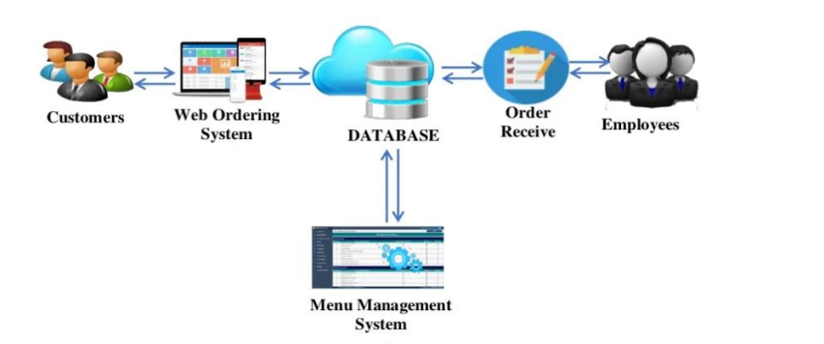
Block Diagram
K.L.N.C.I.T/ECE
First Review

Slide 17
Software/Hardware Requirements
Software:
Front-end:
HTML, CSS, Javascript, bootstrap
Back-end:
PHP, MySQL, Firebase
Tool:
Visual studio code, Xampp.
Hardware:
Ram: 512 GB
Disk Space: 30GB
K.L.N.C.I.T/CSE
Zeroth Review

Slide 18
Modules Completed(35%)
Front-end(25%):
Home , verification Module.
Home Food and Restaurant Food, Category, order Module.
Back-end(10%):
Database design, Idea visualizing Module
K.L.N.C.I.T/CSE
Zeroth Review

Slide 19
Advantages & Applications
Advantages:
• It is quick, simple, and pleasant.
• Managing an online menu is easier.
• Access is only a click away.
• Less work for you
Application:
Restaurants, takeaways, and businesses that sell food to go profit from internet meal ordering software designed specifically for them.
Customers like the ease of online meal ordering, which is why it is expanding quickly
K.L.N.C.I.T/CSE
First Review

Slide 20
References
Web based application for orering raw food materials.
Ritha layona, Budi yuliyonta (2021).
Kirti Bhandge, Tejas Shinde, Dheeraj Ingale, Neeraj Solanki, Reshma Totare,”A Proposed System for Touchpad Based Food Ordering System Using Android Application”, International Journal of Advanced Research in Computer Science Technology (IJARCST 2020).
Varsha Chavan, Priya Jadhav,Snehal Korade,Priyanka Teli, ”Implementing Customizable Online Food Ordering System Using Web Based Application”, International Journal of Innovative Science, Engineering Technology(IJISET) 2019.
Resham Shinde, Priyanka Thakare, Neha Dhomne, Sushmita Sarkar, ”Design and Implementation of Digital dining in Restaurants using Android”, International Journal of Advance Research in Computer Science and Management Studies 2018.
K.L.N.C.I.T/CSE
ZerothReview

Slide 21
Thank you
K.L.N.C.I.T/CSE
Zeroth Review

